Slide 1
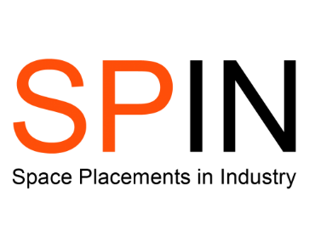
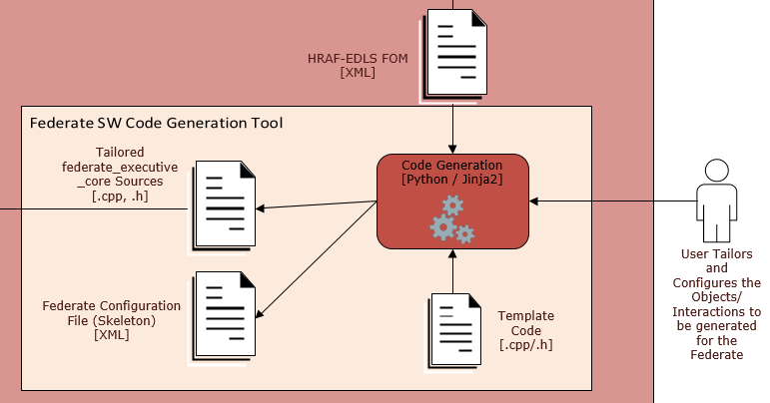
Model-Based and Software Systems Engineering
Faith Lunt – faith-lunt@live.com
1 - Abstract
This project is an extension of the HRAF Pilot 3 ESA activity. The focus was to create a tool capable of automatically generating the interface software based upon a model. A Parser was developed in Python, where data could be extracted from multiple files and visually represented using a tree.
2 - Background
HRAF (Harwell Robotics and Autonomy Facility) is an ESA activity which looks to grow advanced capabilities in field of Verification & Validation (V&V) for Robotic and Autonomous Systems. HRAF Pilot 3 (or HRAF Exploration) is a recently completed ESA activity led by GMV to develop a distributed simulation environment, with test scenarios including Mars Sample Return (MSR) and Asteroid Descent & Landing, and relies on Model-Based, and Model-Driven techniques.
3 - Project
The focus of this project is to extend the baseline capabilities of the distributed simulator, by developing a tool capable of automatically generating the interface software based upon a model, or other description of the interfaces. Currently this task is performed via manual coding which is time consuming and is susceptible to human error, requiring large development and test resources.
Figure 1 – Diagram of tool
4 – Python
Upon starting the project, it became clear that the initial goal was more complicated than first expected, especially as I had no previous Python experience. We discussed realistic expectations, which would allow me to learn at my own pace while still contributing to the project.
Three main aims were created:
Develop a Python script which can parse a Federation Object Model (FOM) file.
Extend the script to parse multiple files and combine their outputs.
Create a Python script which can generate C++ source code from the parsed FOM file, for use in the simulation environment.
A graphical interface can now be created to allow the user to access the data with ease, without searching through lines of code.
Figure 2 –
HRAF FOM Design
Figure 3 – Section of the Anytree
Figure 4 – Section of the parsing output
5 – Results
A Parser written in Python was developed, where data could be extracted from multiple files and visually represented using a tree. This will allow it to be used in conjunction with the Jinja2 templating library to generate C++ source code, which can then be used within the simulation environment.
6 – Acknowledgements
Thank you to Steven Kay and Aron Kisdi at GMV NSL for taking me on for this internship. They have been very welcoming and patient with me, as I had no previous computing experience other than MATLAB. The mentoring and help I have received has been second to none, and I’ve had an extremely positive experience. I hope to further my software engineering skills over my final year at university, and see what doors open when I graduate.

